Slide 1

Industrial Training Project Presentation
Topic - “Live Portfolio Full Stack Webpage Development”
Submitted By-:
Manish Gautam
(181500366)
Department of Computer Engineering and Applications
Institute of Engineering and Technology
GLA University
Mathura-281406, India

Slide 3
Problem Statement
No matter where you’re at in your career, it’s always important to have a good place to show off your work and projects you’ve collaborated on. A portfolio website makes it easy.
Portfolio of a person reflect that individual well as typically it showcases the best samples of ones work – ones artwork, learning, practices, experiences, etc. so that a company prospects can actually see ones style and samples prior to deciding if they will want to hire them.

Slide 4
What Is Personal Portfolio Website ?
A portfolio website should tell a story to the viewers, and the title to that story should be "What if this person was a website?".
Portfolios are static websites, which can fall under a lot of categories, like one explaining why the person should be hired with all their work till that time showcased, or can be a story or a timeline depicting the work experience with few projects to showcase, etc.

Slide 5
Motivation Behind …
The motivation behind learning Full Stack technologies is that we can develop both client as well as server software. I generally go for a project that really is of my knowledge area and also improves my learning while working on it.
Hereby the best way to get a kick start is to make a website which is much familiar project that even gives pleasure to showcase. So, I decided to create a Live Personal portfolio website to showcase the skills that I have acquired and my learning up till now.
I also wanted to improvise my front-end skills, specifically in HTML, CSS and in JavaScript so creating a personal portfolio website is a nice way to learn more about live projects.

Slide 6

Technologies Used
For the completion of the task the following Web-languages and scripts have been used:
HTML
CSS
JavaScript

Slide 7
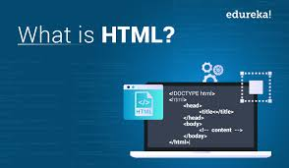
HTML
HTML stands for Hypertext Markup Language, and
it is the most widely used language to write Web Pages.
Hypertext refers to the way in which HTML documents are linked together.
Thus, the link available on a webpage is called Hypertext.
As its name suggests, HTML is a Markup Language which means you use HTML to simply "mark-up" a text document with tags that tell a Web browser how to structure it to display.
HTML is being widely used to format web pages with the help of different tags available in HTML language.
HTML is the language for publishing web pages on the WWW (World-Wide Web).
HTML is a Document Description Language (aka Document Markup Language).
HTML is NOT a programming language like C/C++/C#/Java, which is used to implement programming algorithm.
You need a web browser to view the HTML pages. The web browsers do not display the HTML tags, but uses the tags to interpret the content of the web pages.
An HTML document is a text document, and it is human-readable

Slide 8
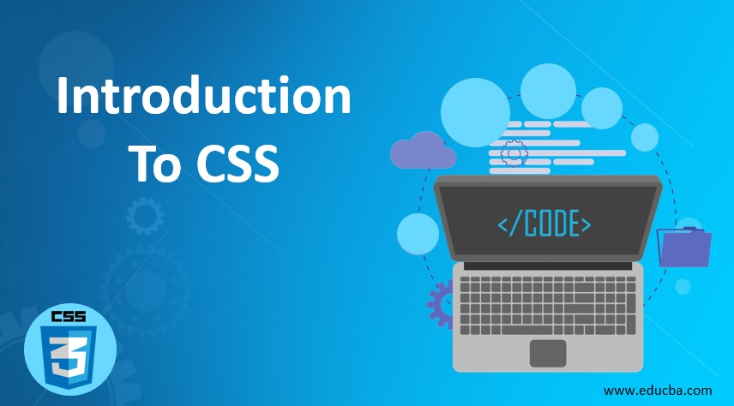
CSS
CSS is acronym for Cascading Style Sheets and is a markup language
responsible for how your web pages will look like.
It controls the colors, fonts, and layouts of your website elements.
It is a style sheet language used for describing the presentation of a document written in a markup language like HTML. CSS is designed to enable the separation of presentation and content, including layout, colors, and fonts.
CSS has a simple syntax and uses a number of English keywords to specify the names of various style properties.
A CSS comprises of style rules that are interpreted by the browser and then applied to the corresponding elements in your document.
Each rule or rule-set consists of one or more selectors, and a declaration block.
A style rule is made of three parts :−
Selector − A selector is an HTML tag at which a style will be applied. This could be any tag like <h1> or <table> etc.
Property − A property is a type of attribute of HTML tag. Put simply, all the HTML attributes are converted into CSS properties. They could be color, border etc.
Value − Values are assigned to properties. For example, color property can have value either red or #F1F1F1 etc.

Slide 9
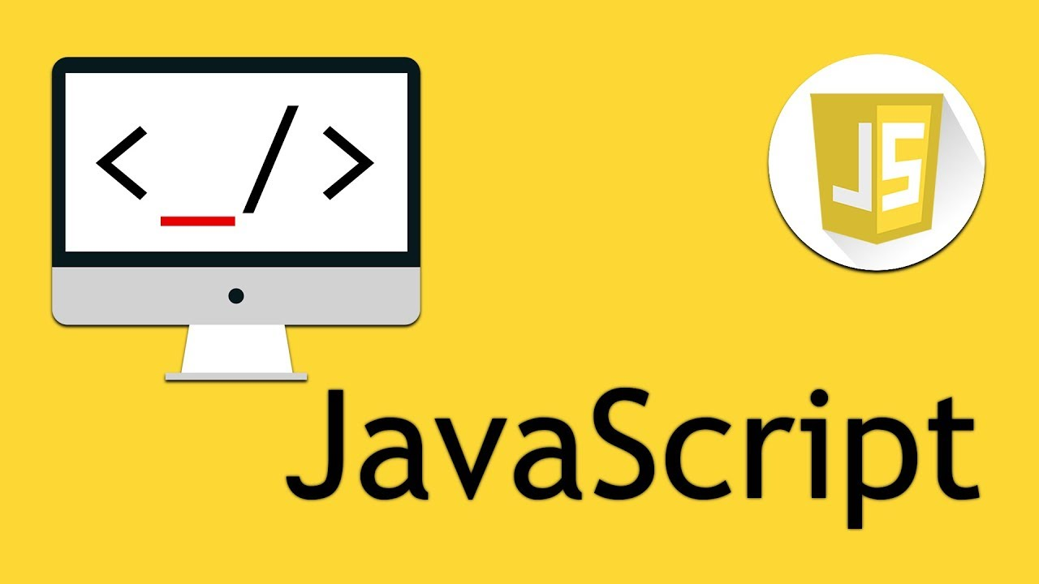
JavaScript
JavaScript is a client-side scripting language and used to build interactive,
Websites with dynamic features and to validate form data.
JavaScript is high-level, dynamic and browser interpreted programming language, supported by all modern web browsers.
Apart from web browser, JavaScript is also used to build scalable web applications using Node JS. JavaScript is also being used widely in game development and Mobile application development.
JavaScript is also known as the Programming Language of web as it is the only programming language for Web browsers. JavaScript is an object-based scripting language which is lightweight and cross-platform.
The programs in this language are called scripts. They can be written right in a web page’s HTML and run automatically as the page loads. Scripts are provided and executed as plain text. They don’t need special preparation or compilation to run.
The browser has an embedded engine sometimes called a “JavaScript virtual machine”.

Slide 10

Implementation And User Interface (UI):

Slide 11
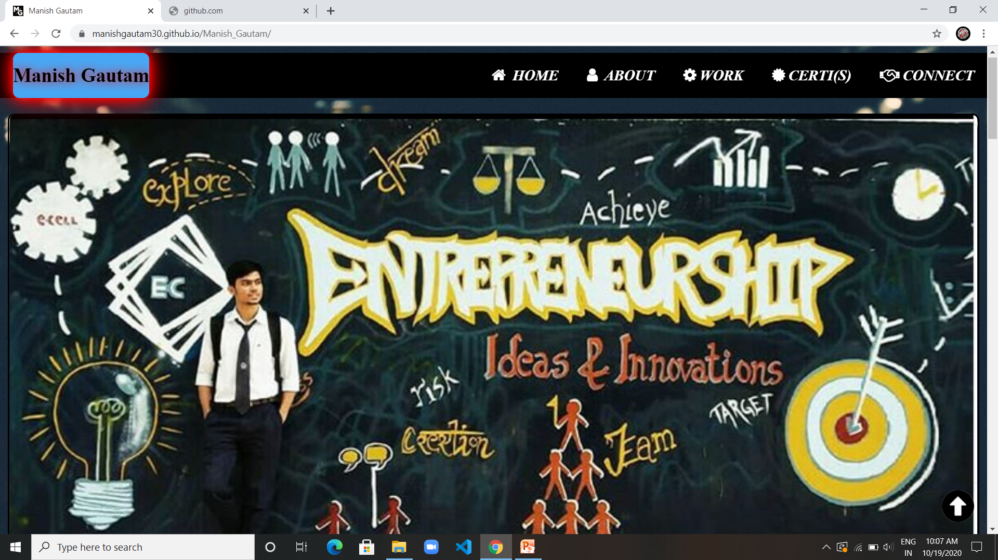
This webpage is Live and online Using the Git-Hub live pages.
Full window Size view of the first section of portfolio.

Slide 12
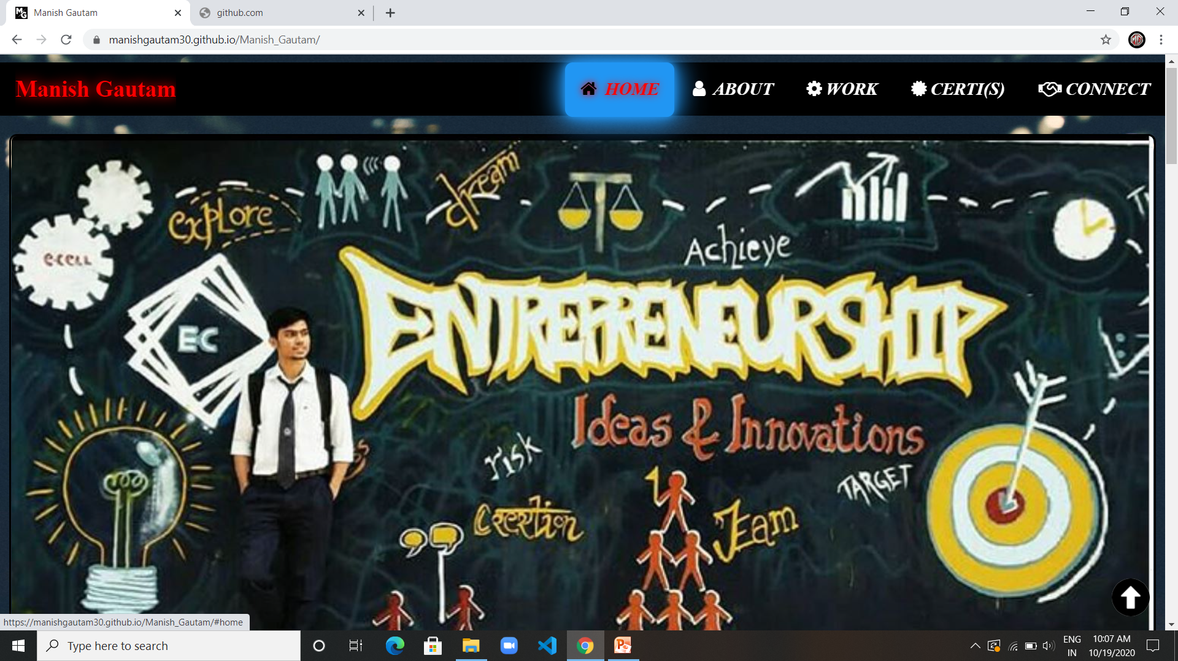
Navigation bar in full view with the blue hover shadow button.

Slide 13
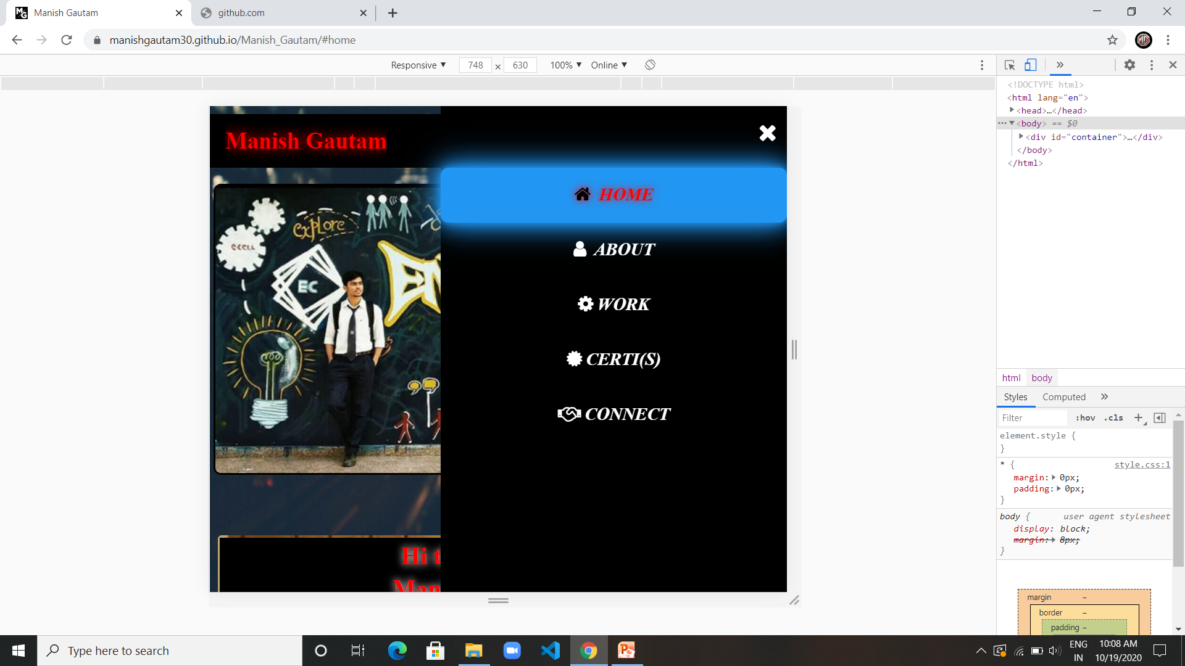
Background image also decreased in size as the screen size is reduced.
The list style changes from ROW style to COLUMN style on small screen.

Slide 14
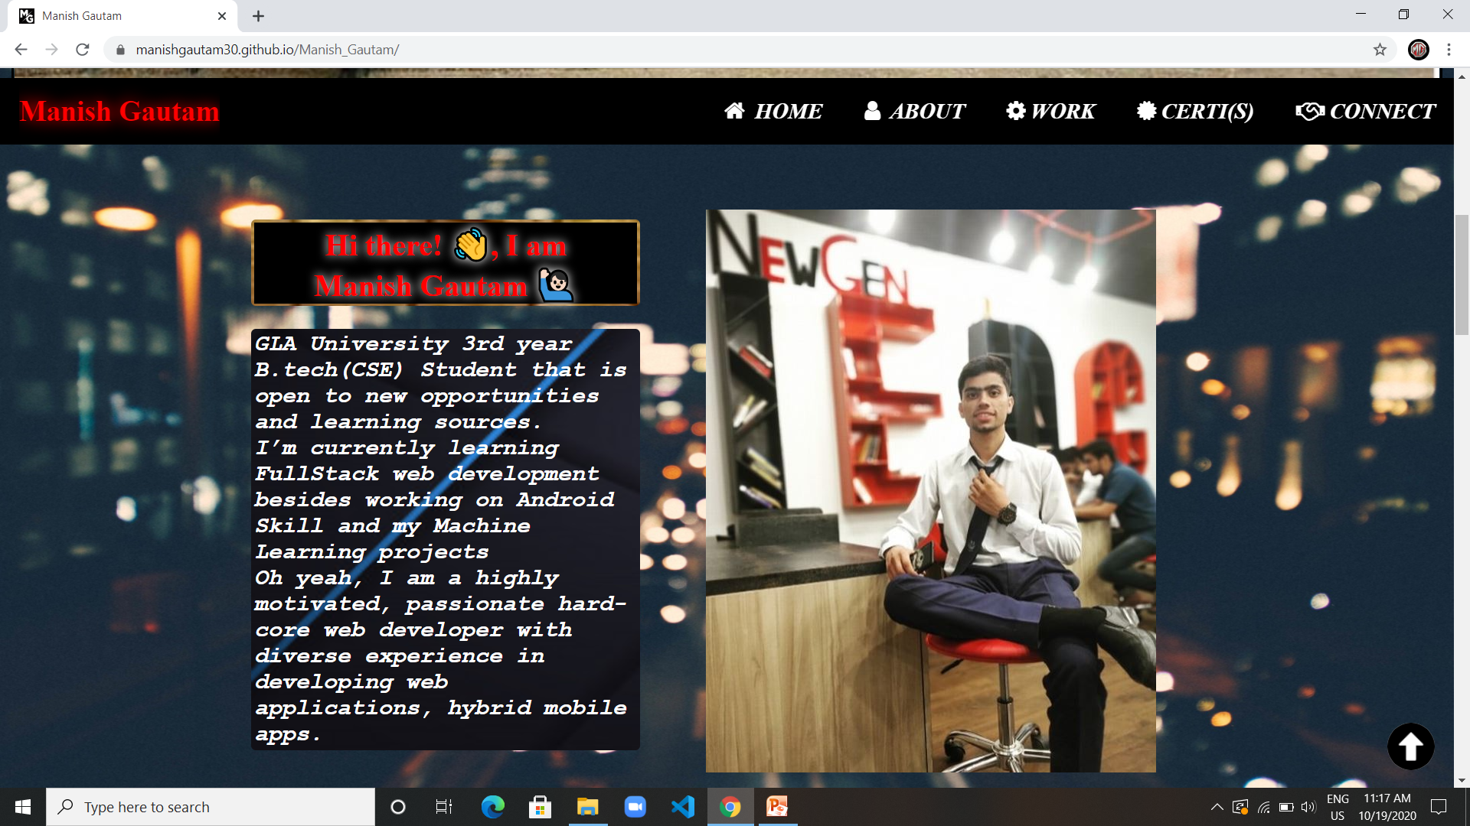
This is the full view of next section ABOUT ME with a heading, a paragraph and an image.

Slide 15
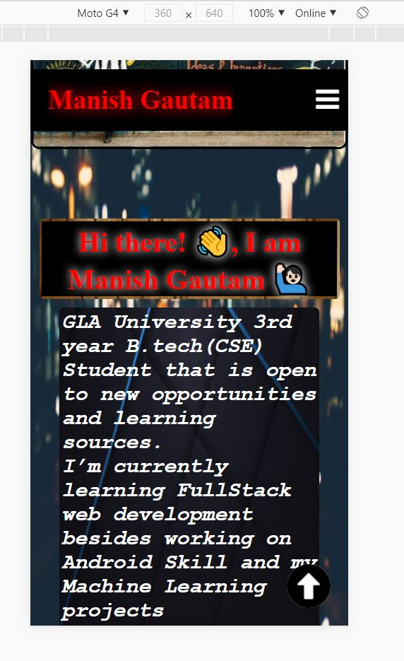
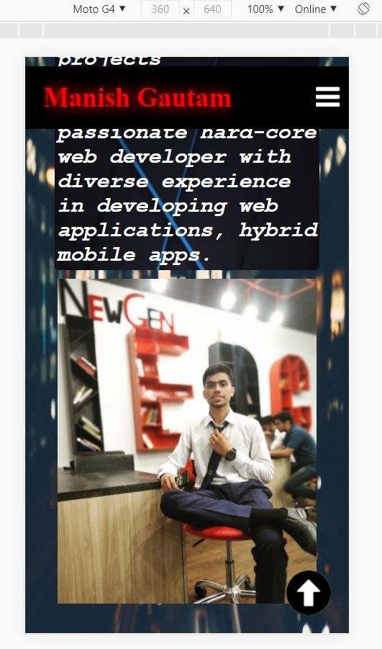
1
2
This is the responsive view of About me section the turns into column view using the flex-box

Slide 16
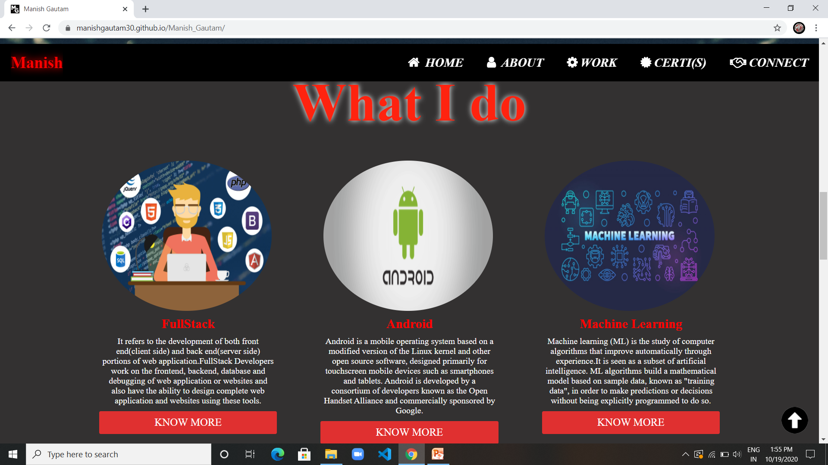
This is the “What I do” view that tell about my fields of learning and implementation.

Slide 17
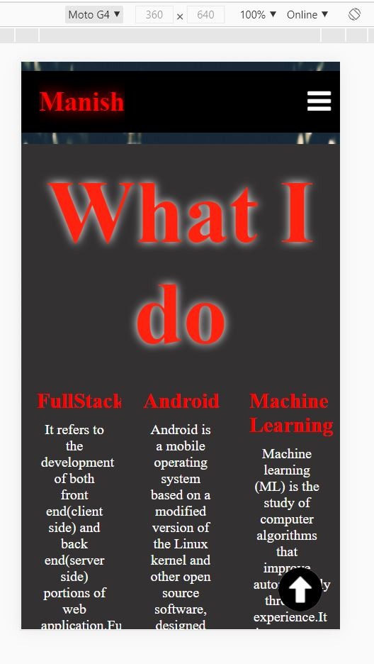
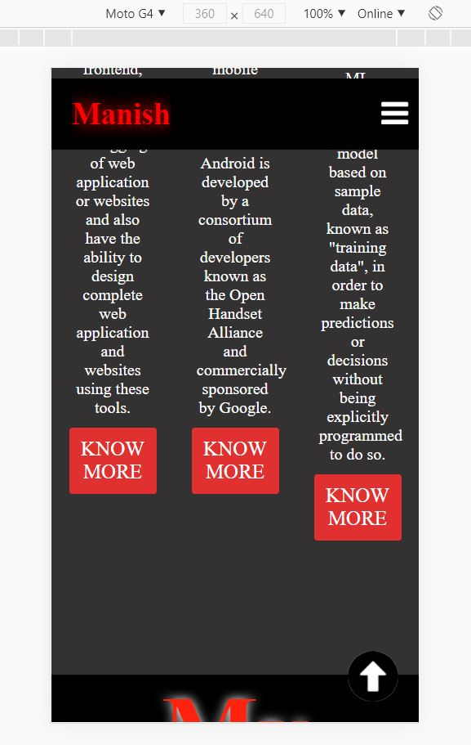
1
2
This is the responsive view of What I do section that turns also into column view using the flex-box .
At the end of this , the space already starts increasing as soon as the screen size is decreased.

Slide 18
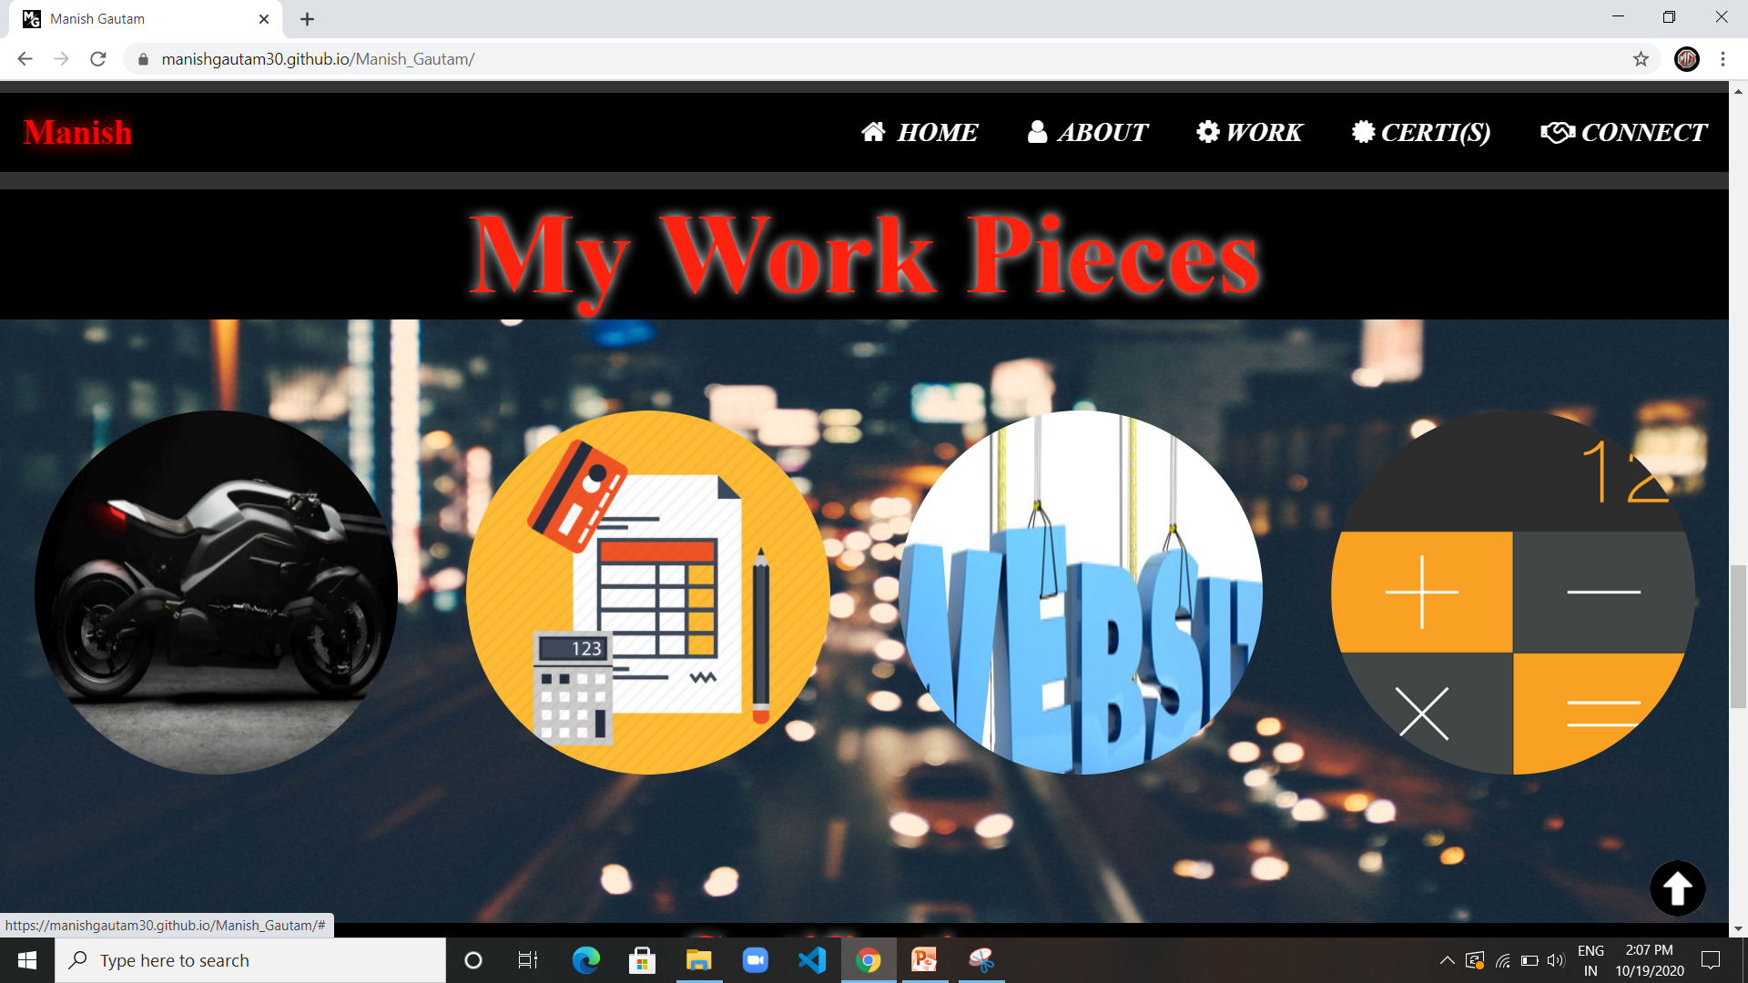
This is the “Work” view that tells about my implementation and the projects done for my practice and learning.

Slide 19
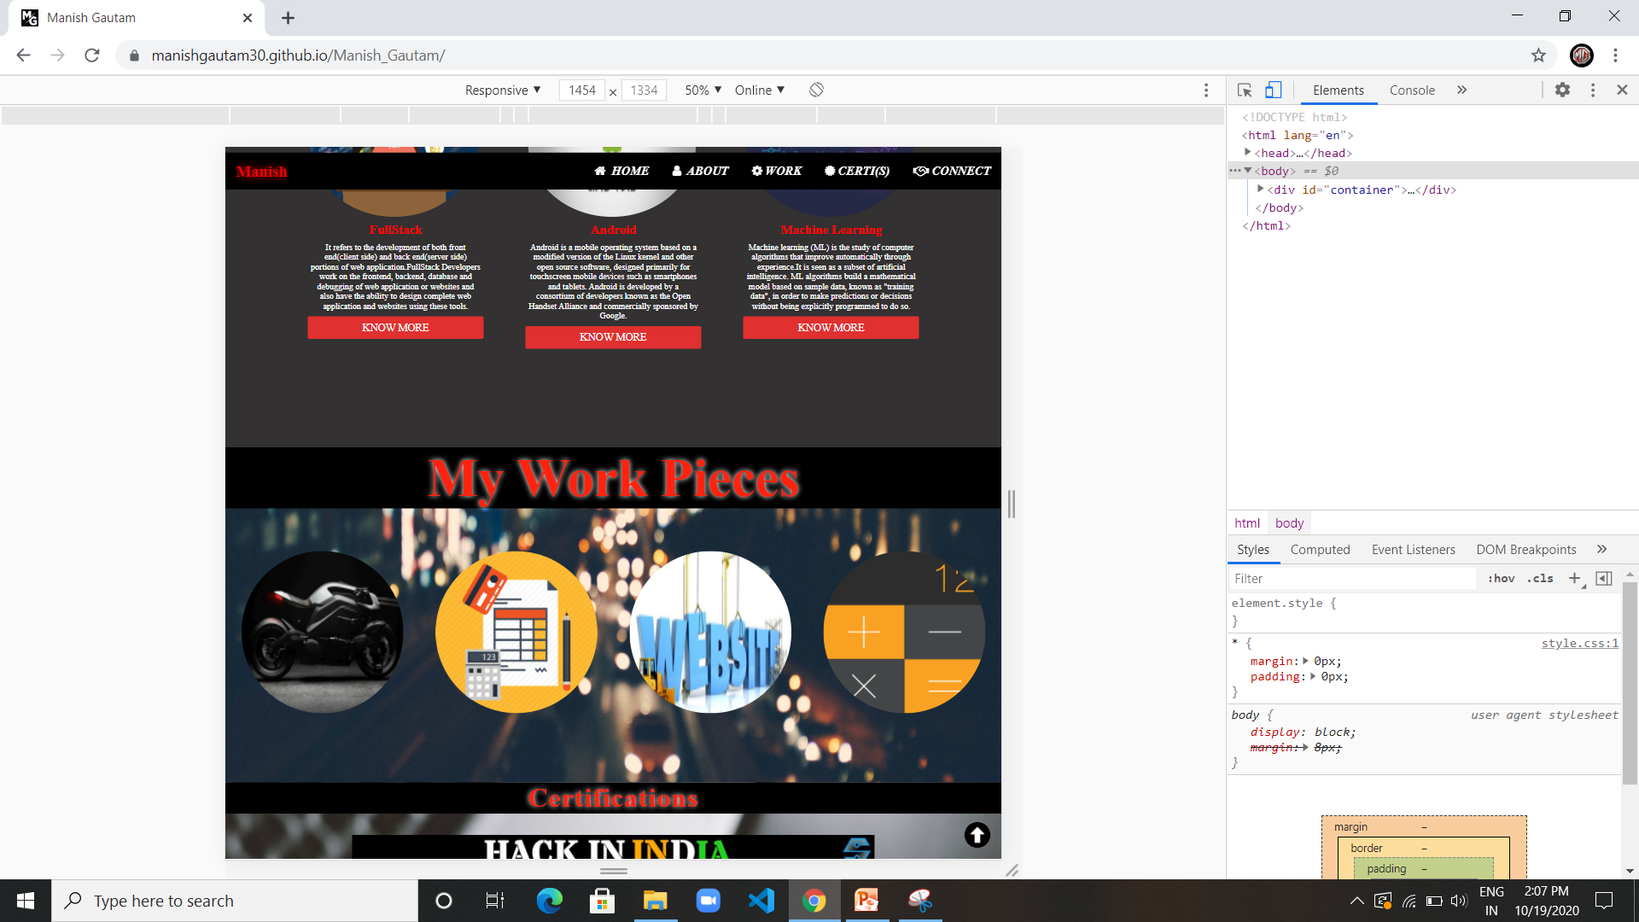
This is the full size view of my work section.

Slide 20
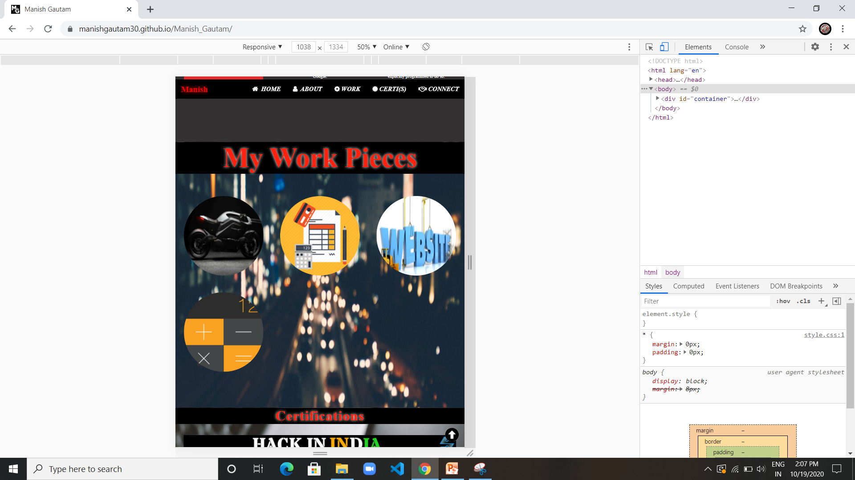
This is the tablet/i-pad size view of my work section.

Slide 21
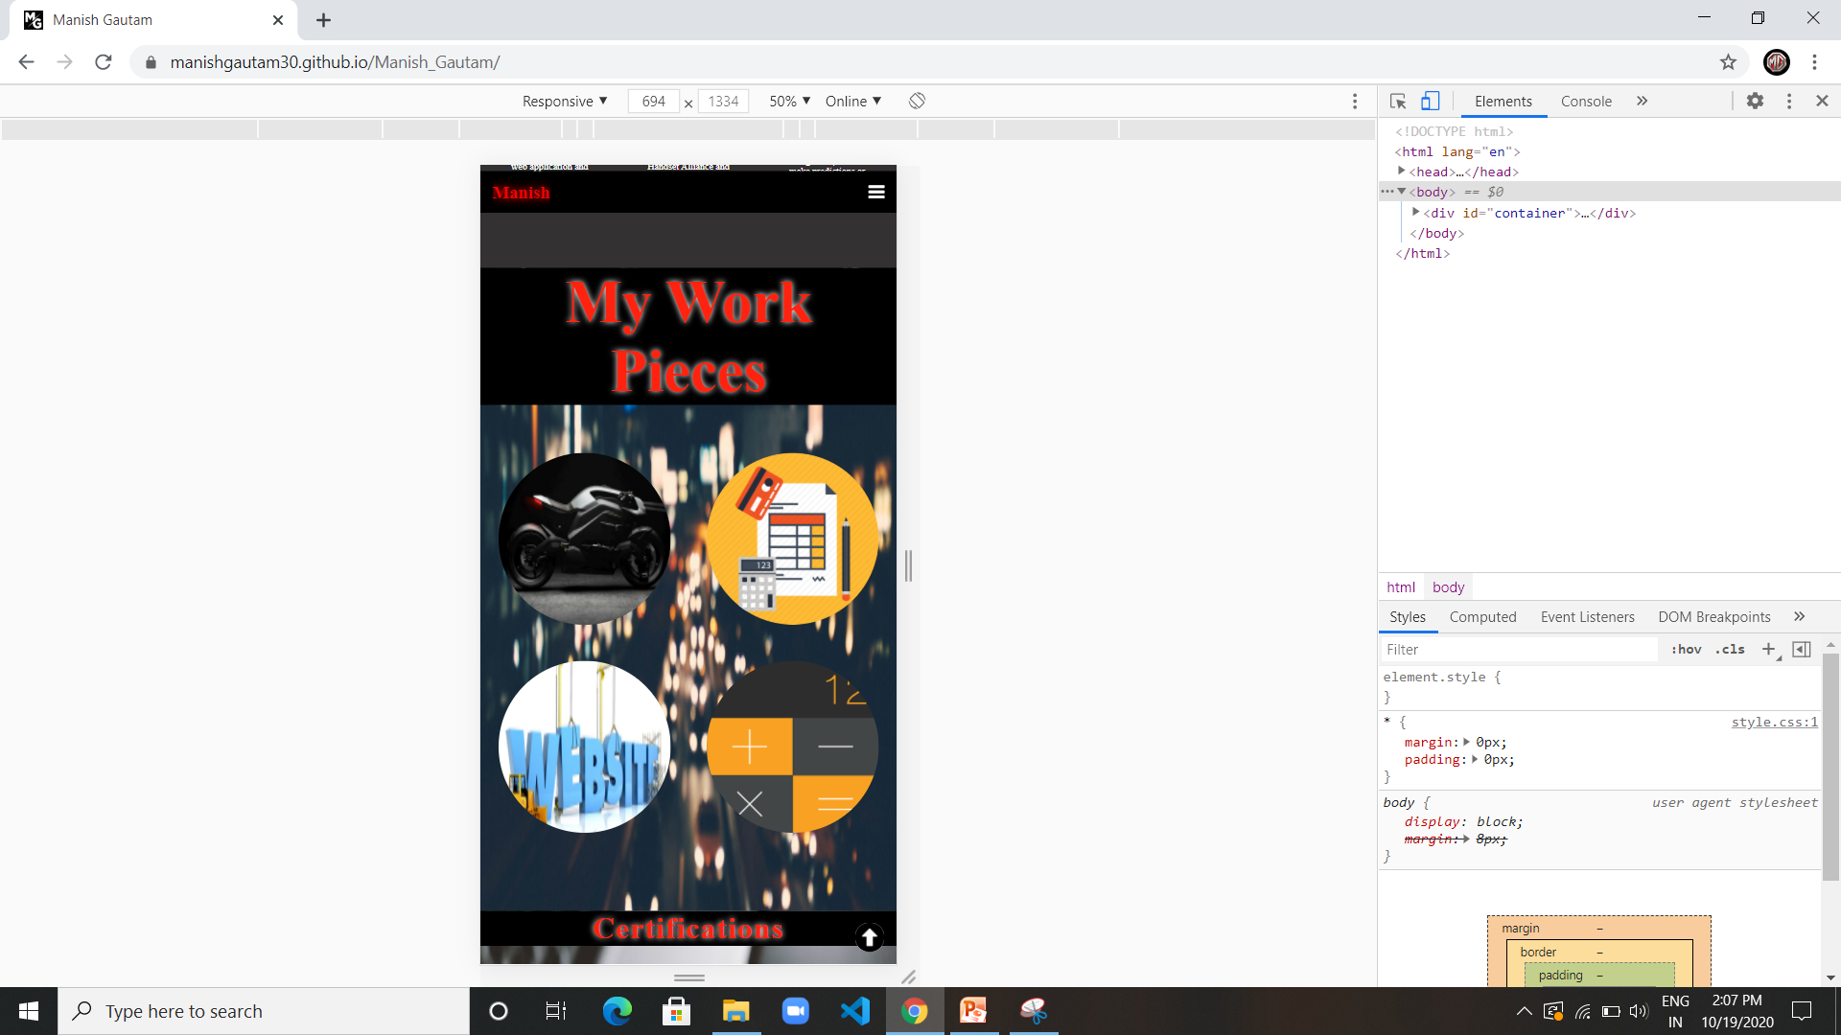
This is the small size view of my work section.

Slide 22
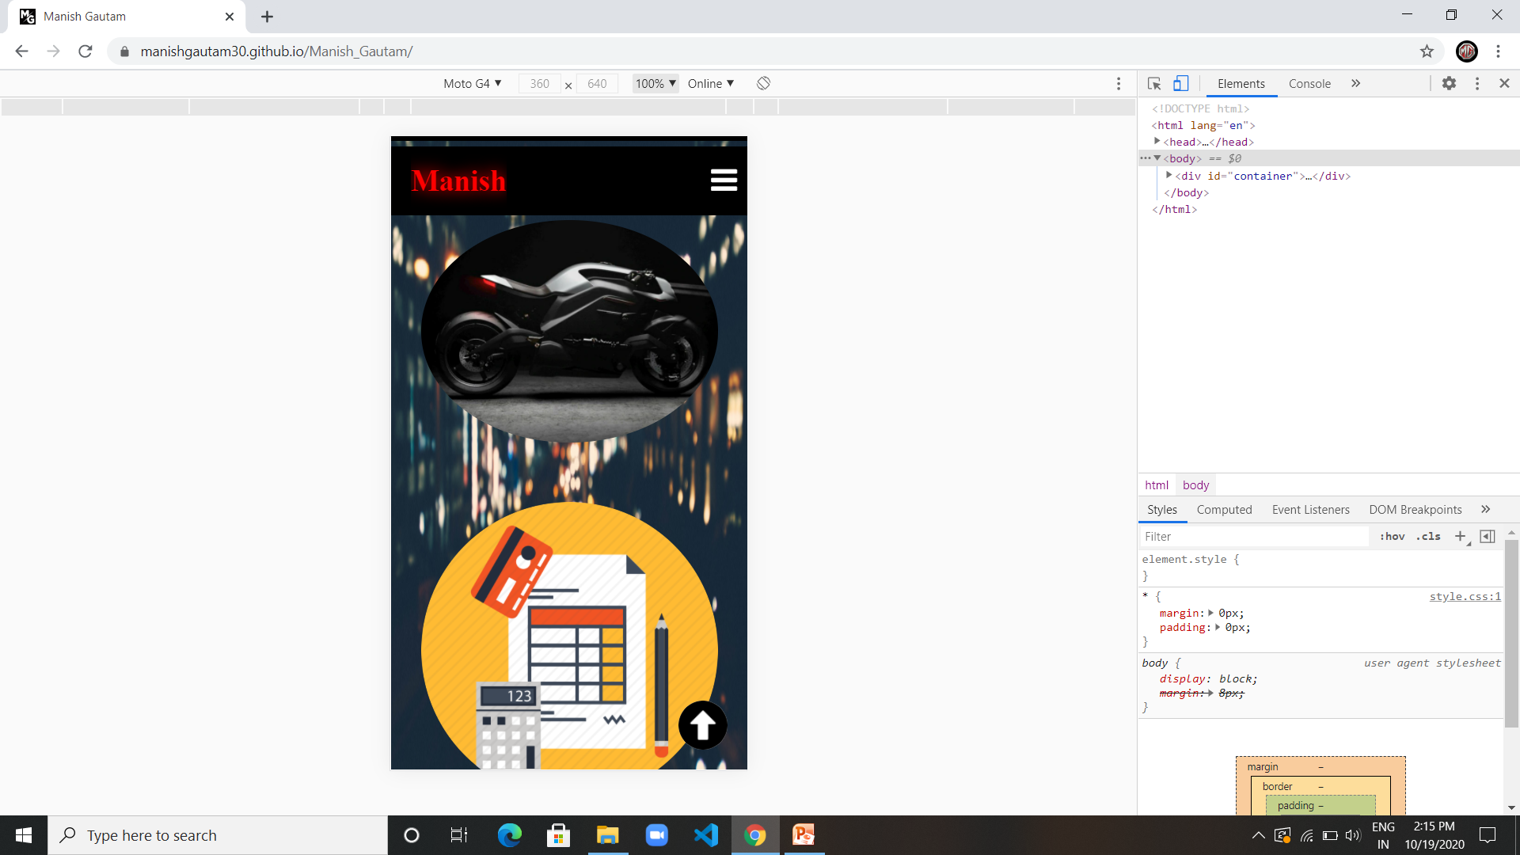
This is the mobile phone size view of my work section.
The mobile device used for reference is of company Motorola version G4 with 360 x 640 dimensions.

Slide 23
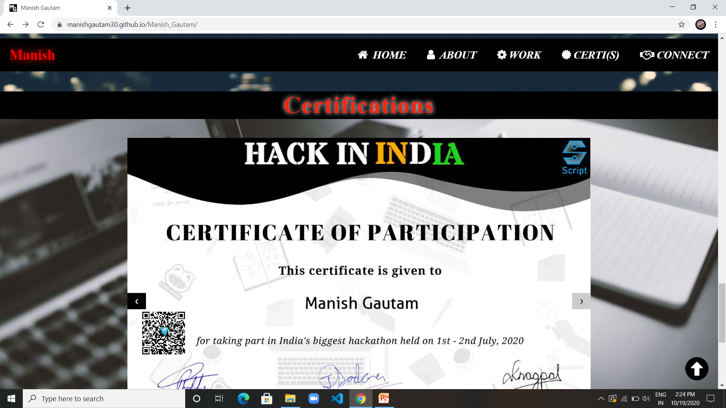
This is the “certifications” view that tells about my certifications completed during my learning.

Slide 24
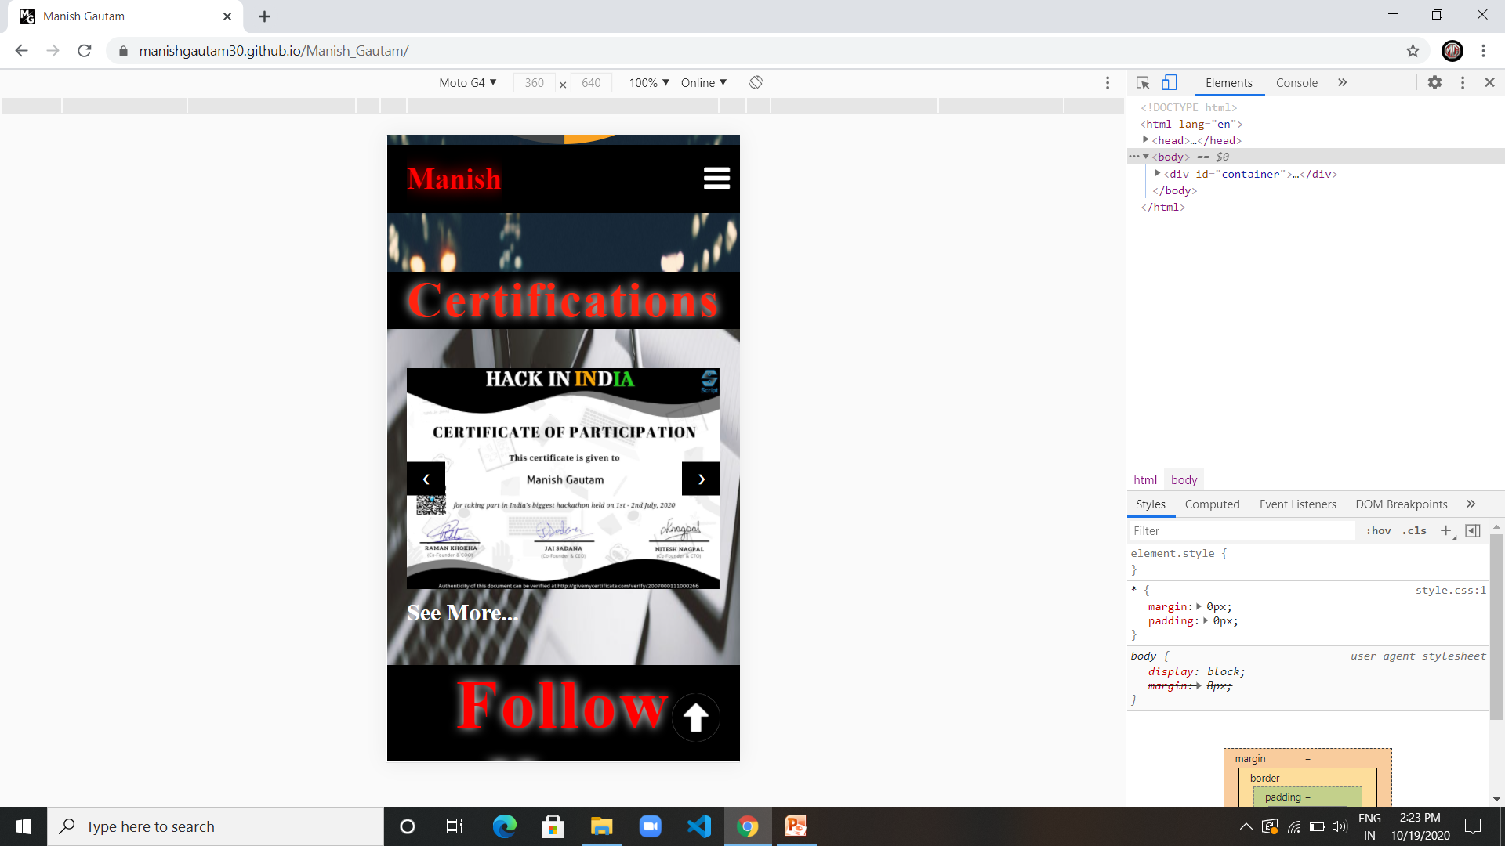
This is the responsive view of my certifications.
This is the see more button to go on my all certifications webpage.

Slide 25
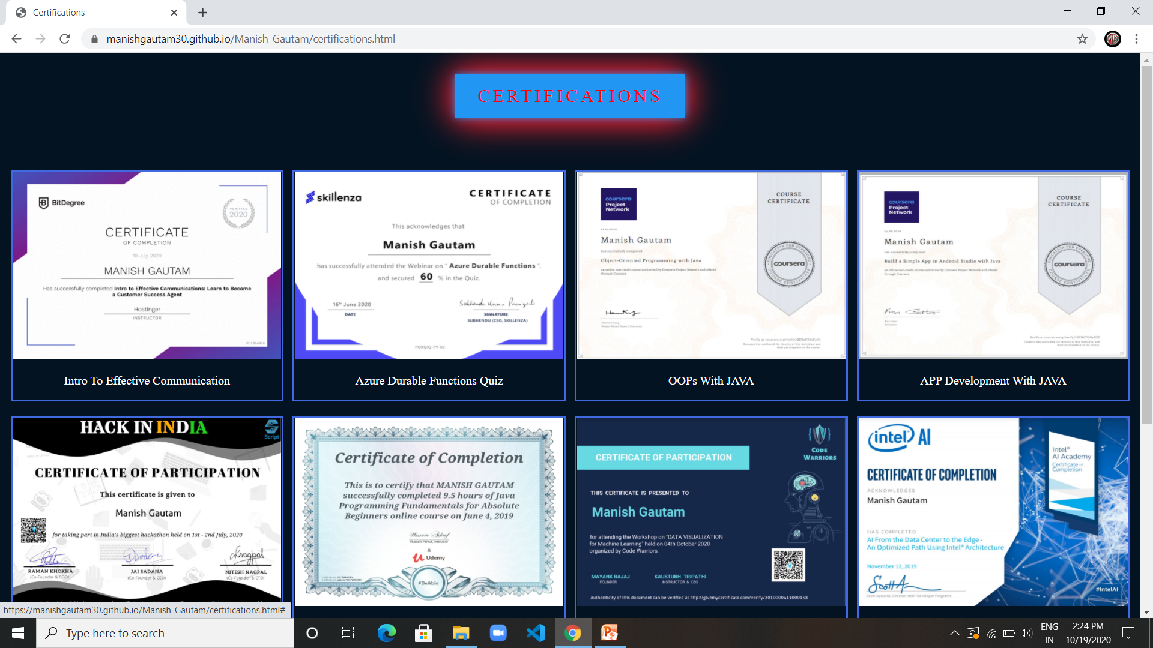
This is another webpage of my all certifications

Slide 26
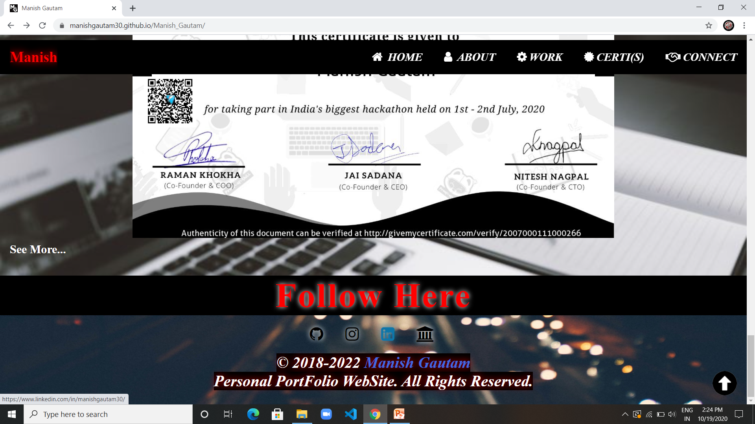
This is last section of my portfolio webpage i.e. the footer section
It consists of 4 hover buttons
1- git-hub
2- instagram
3- linkedin
4- hackerrank

Slide 27
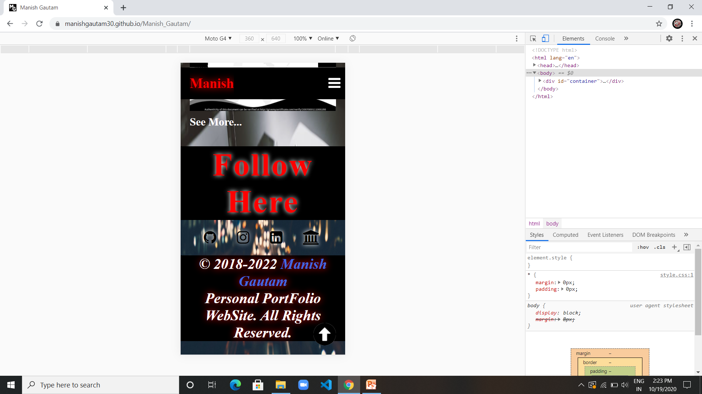
This is the responsiveness view of last section of my portfolio webpage i.e. the footer section

Slide 28
Link for the code: https://github.com/manishgautam30/Manish_Gautam
Link for the Portfolio-Site: https://manishgautam30.github.io/Manish_Gautam

Slide 29
Thank You!

